Slide 1

MyLegion My Groups:
Member Management
View and edit member information, print membership card and send emails.
2025

Slide 2
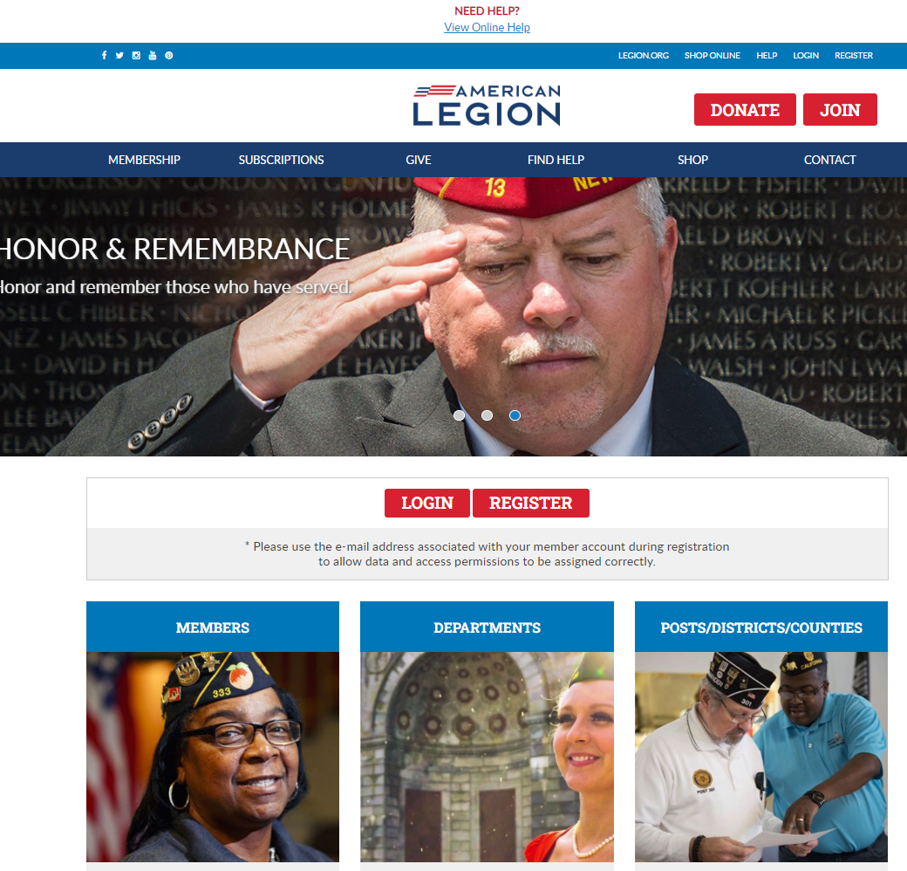
Notes:
MyLegion provides information on file at Department and National Headquarters. Log in to view membership details and access administrative tools for leadership.

Slide 3
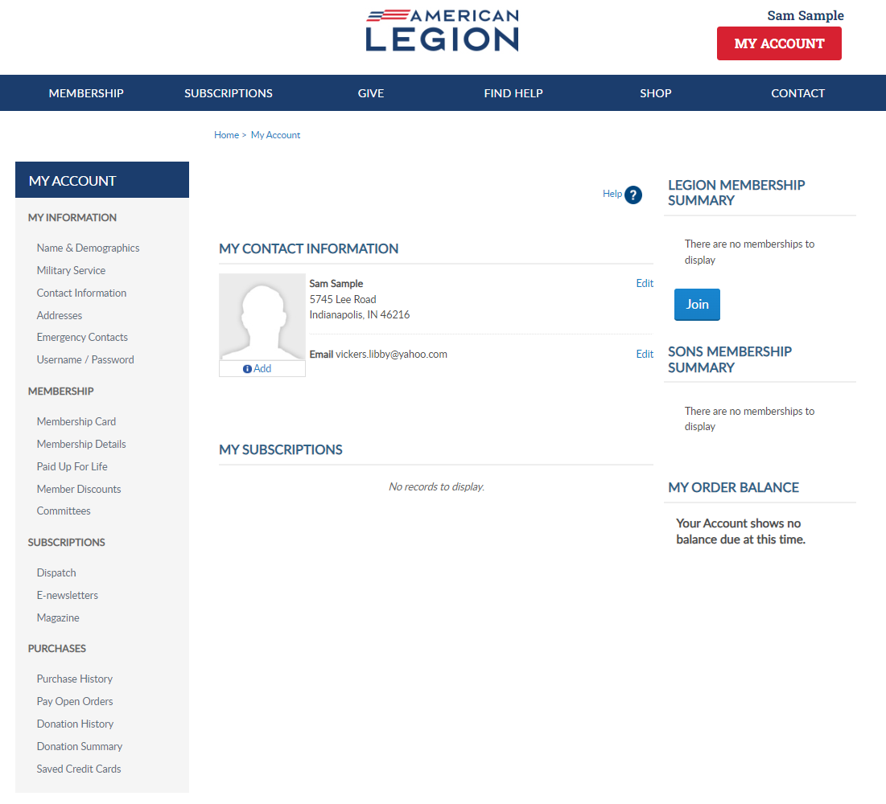
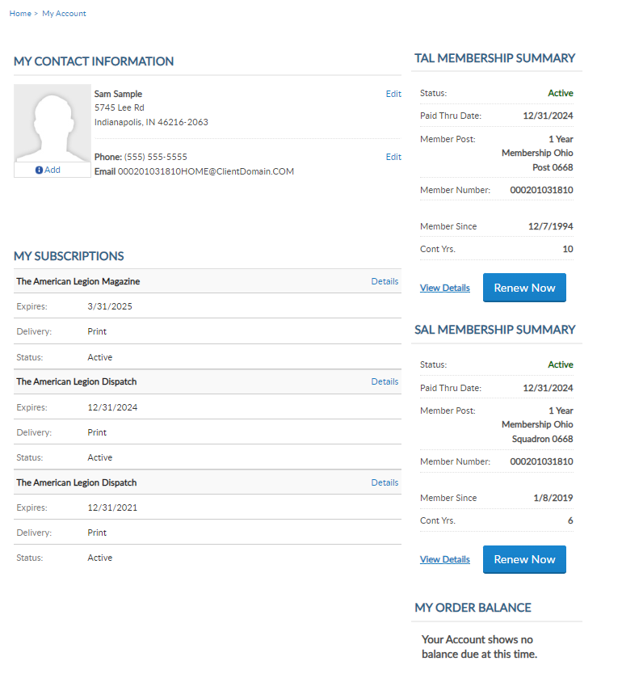

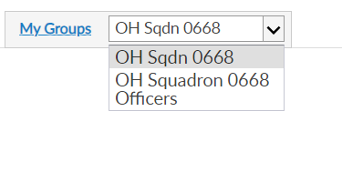
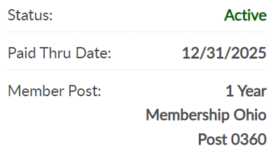
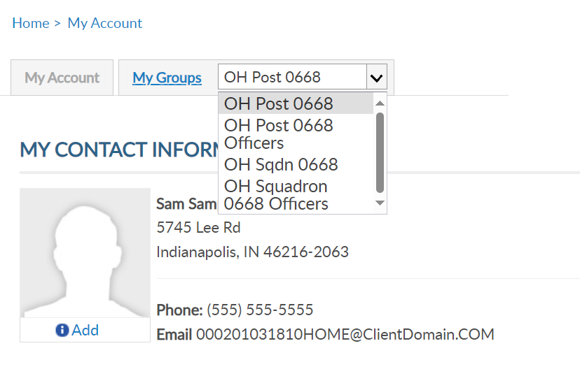

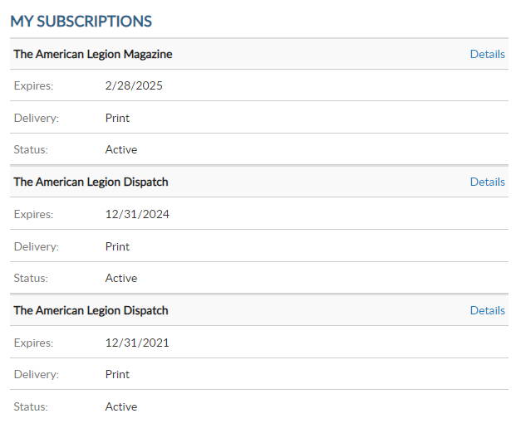
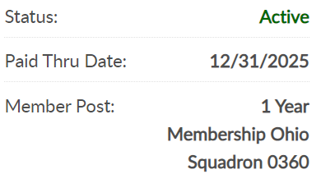

MY GROUPS
Squadron Adjutant
LGN Leadership has LGN and SAL data
Officer Groups: view only
000123456789
PrimaryEmailAddress.com
000123456789
Notes:
This member is a squadron adjutant. <1> Legion leadership will have Legion and SAL data. <2> Officer groups are view only. Officer groups lists the officers on file.
Clicking on the group will navigate you to the administrative side of MyLegion. Let’s look at an officer’s group. <3>

Slide 4
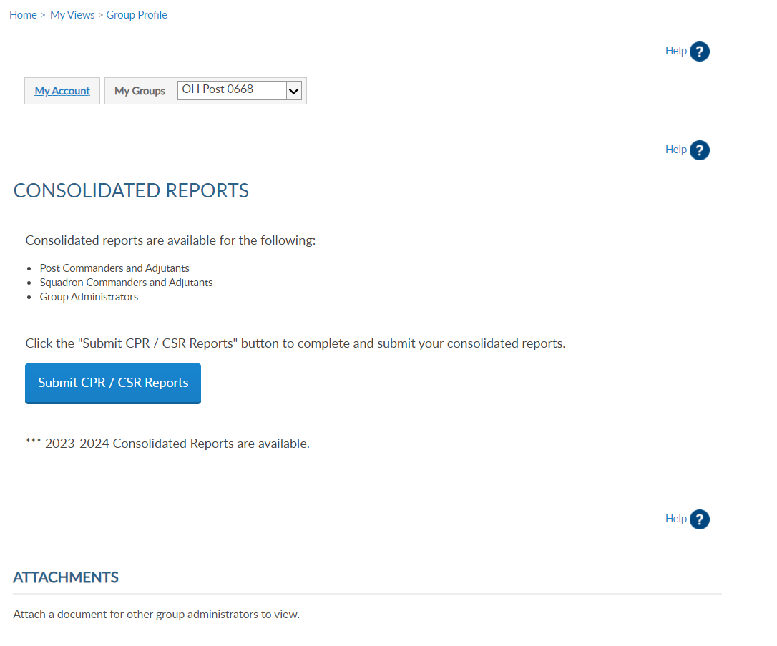
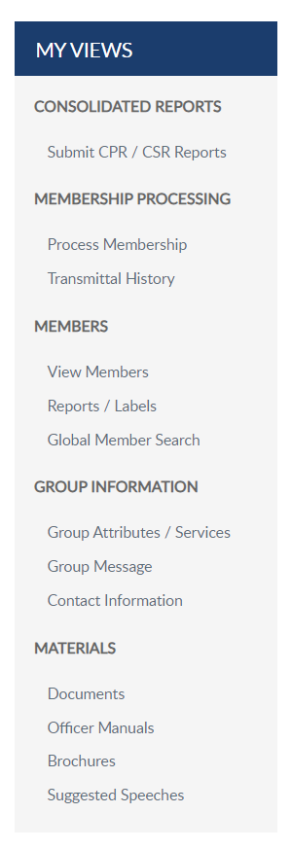
GROUP PROFILE
Notes:
Selecting the squadron group takes you to a Group Profile page which is the administrative side of MyLegion. A new left hand “My Views” menu of administrative tools such as reports, online membership processing, member management, group information and officer materials.

Slide 5
MEMBER INFO
Notes:
View and manage member information using “View Members”. <1> View Members takes you to the membership list.​

Slide 6
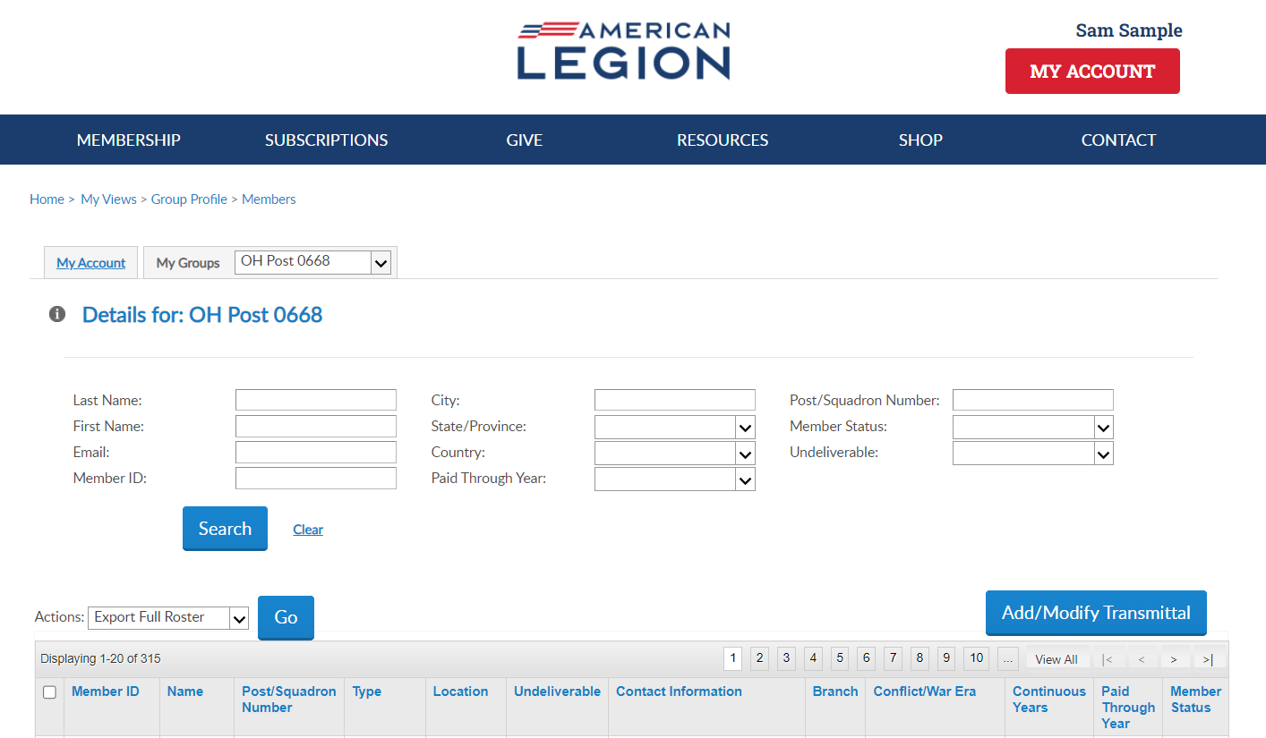


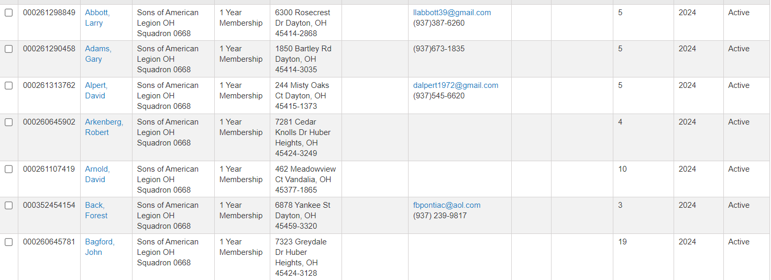
View Members
222555111
Aaron, Greg
Address, City, St Zip
Email Address
Phone Number
2025
112332145
Aaron, Kevin
Address, City, St Zip
Email Address
Phone Number
2025
123456789
Asample, Christoper
Address, City, St Zip
Email Address
Phone Number
2025
122333444
Axel, Jack
Address, City, St Zip
2025
111333222
Bam, Joshua
Address, City, St Zip
2025
222555777
Black, Brian
Address, City, St Zip
Email Address
Phone Number
2025
225558441
Cook, Ralph
Address, City, St Zip
2025
Notes:
The member list includes all members of the squadron since I am in the squadron list. It includes current, deceased and expired members. It does not include members who have transferred out.
<1> Search options allow you to filter out an individual record or a group of members.
The view members list is alphabetical. Click on any of the title columns to resort and navigation icons to go from page to page. New members in a pending transmittal will be in the list as expired with zero continuous years. This information updates when the transmittal completes. ​
The view member list includes member contact and demographic information, last paid membership year and status. Members who have transferred out, will not be included in this listing. To view all members that have paid to your squadron, including those transferred out, go to Reports to generate a Paid Member Listing.​
​
The member list is not the location to create roster reports or mailing labels. To create a roster, return to group profile and go to Reports/Labels.​
​
District and County access allows view only. District and County access will not include Add/Modify transmittal. Learn more about online membership processing in Find Help.
​To edit member information, click on the member’s name. <2>
​
​

Slide 7
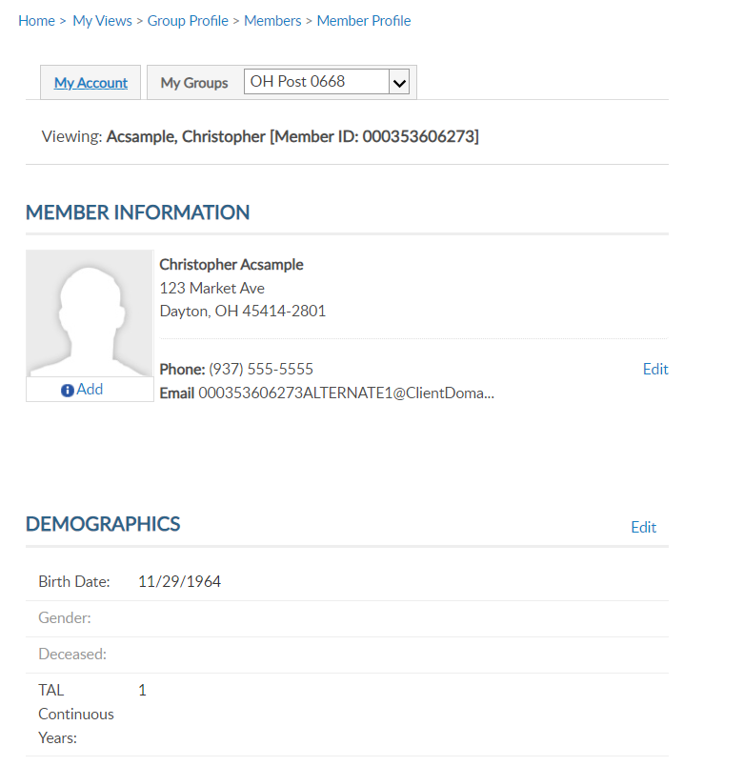

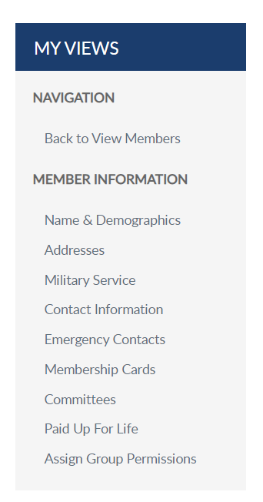
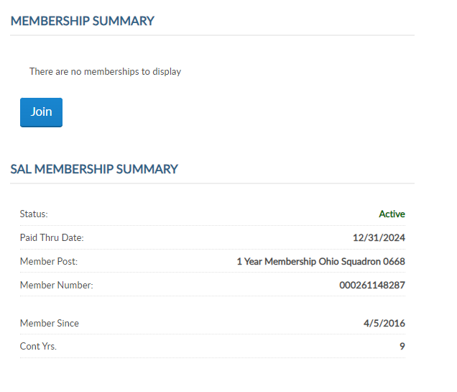
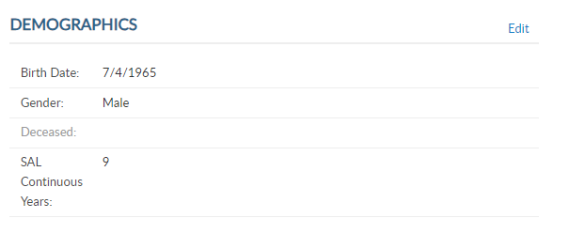
MEMBER INFORMATION
Viewing: Acsample, Christopher [Member ID: 123456789]
12/31/2025
000123456789
5
5
Notes:
Viewing a member displays the member’s name, ID#, contact information, demographics, and membership summaries. For members of both The American Legion and Sons of the American Legion, both membership summaries are displayed. <1>Summaries include; status, paid through year, membership type, and continuous years. The membership ID number is the same for both memberships.

Slide 8
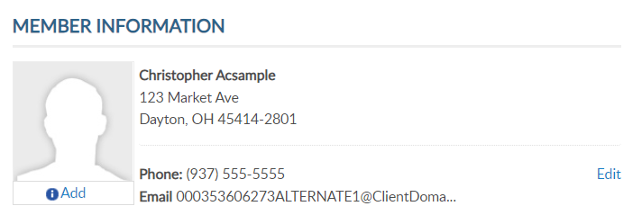
C0NTACT INFORMATION
Viewing: Acsample, Christopher [Member ID: 123456789]
5
Notes:
Contact information includes phone number and email address. You can edit or add contact information by clicking the edit button in member information <1>. You can also select the link from the side menu.

Slide 9
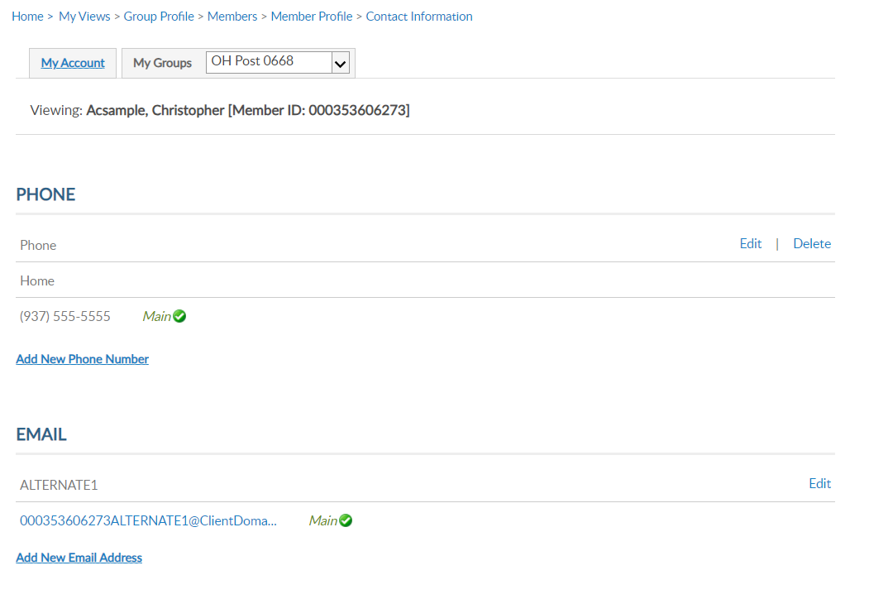
CONTACT INFORMATION
Viewing: Acsample, Christopher [Member ID: 123456789]
Viewing: Acsample, Christopher [Member ID: 123456789]
Notes:
Using, edit, delete or add update as needed.
Member’s can have multiple emails and phone numbers. A total of 3 emails can be on a member’s record.
Updating the main email addresses updates the email associated with your myLegion account. All email communications for myLegion password and username are sent to the main address.
If one email is on file, no delete option will be available. An email must exist on your record to have a myLegion account. In the event you do want to delete your email address, contact National MyLegion support staff to delete.

Slide 10
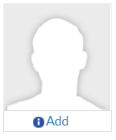
ADD / MANAGE IMAGE
Viewing: Acsample, Christopher [Member ID: 123456789]
5
Notes:
Members and Administrative officers can upload a picture by clicking Add. <1>

Slide 11
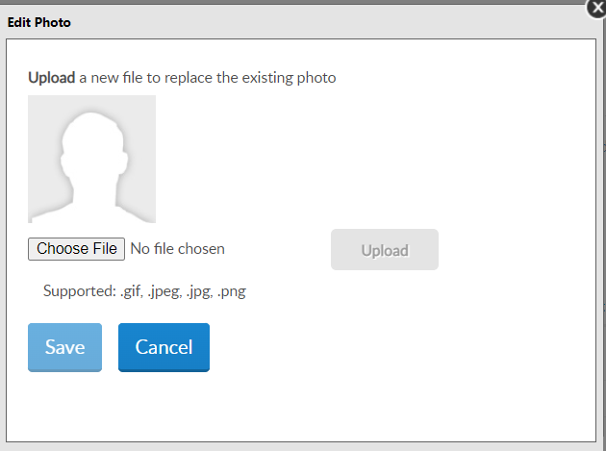
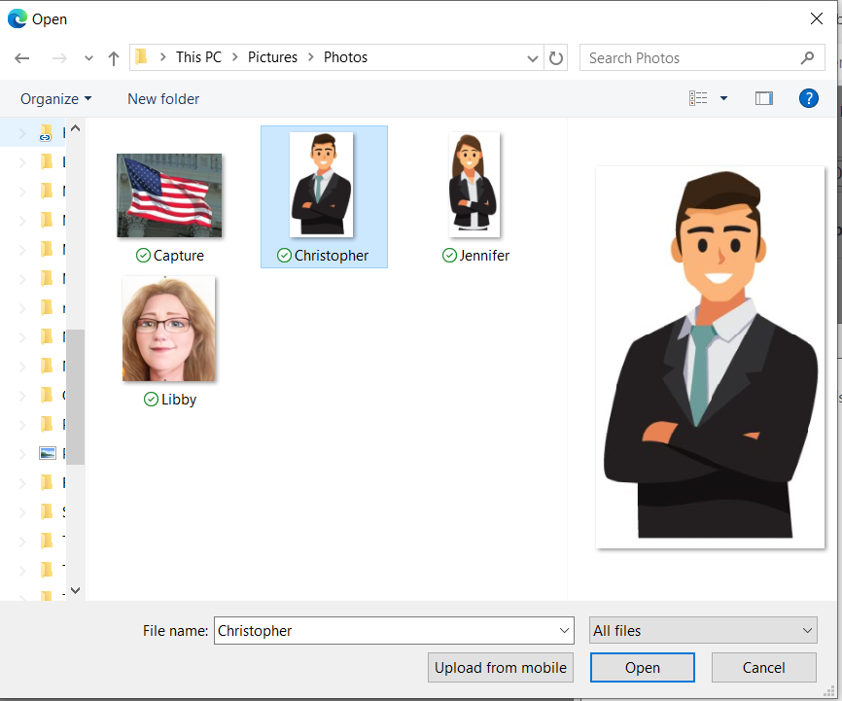
ADD / MANAGE IMAGE
Notes:
The edit photo window opens for you to choose your image to display. Only the supported file types can be selected. Select “Choose File” and <1>
locate the image file. Select the file and click Open. <2>

Slide 12
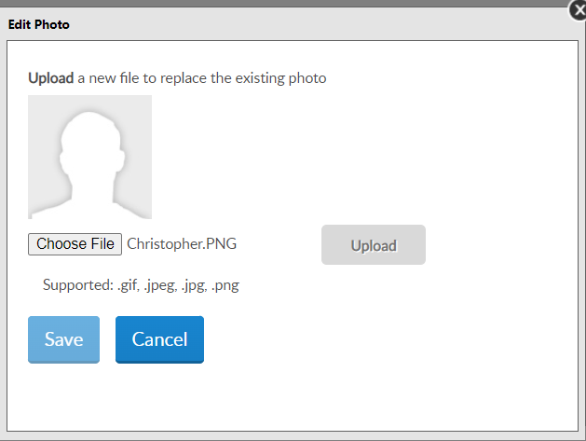
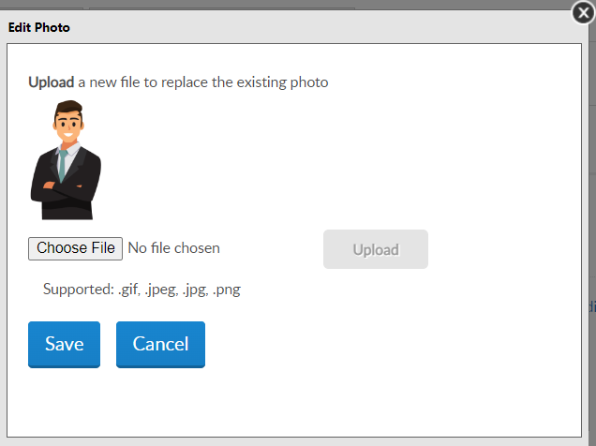
ADD / MANAGE IMAGE
Notes:
The file name appears. Select “Upload”. <1> The image displays. Click Save <2> to save image or cancel and no image will be saved on the member’s record.

Slide 13
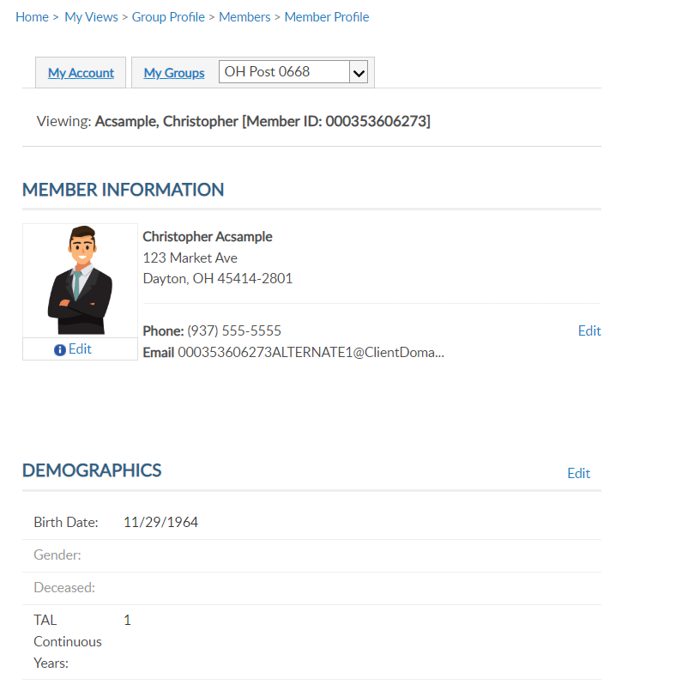
NAME & DEMOGRAPHICS
Viewing: Acsample, Christopher [Member ID: 123456789]
Address update only.
5
Notes:
Once you add an image, you can edit or remove by clicking on Edit below the image.
The main view member page and have edit links <1> to update address, phone number, date of birth, gender, deceased status and continuous years. The sections are separate. To update a member’s name, you must use the left menu option for Name & Demographics <2>.

Slide 14
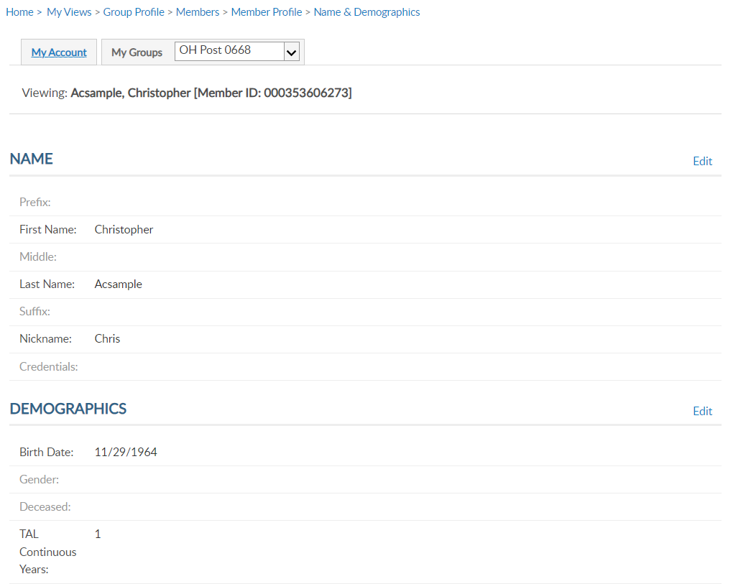
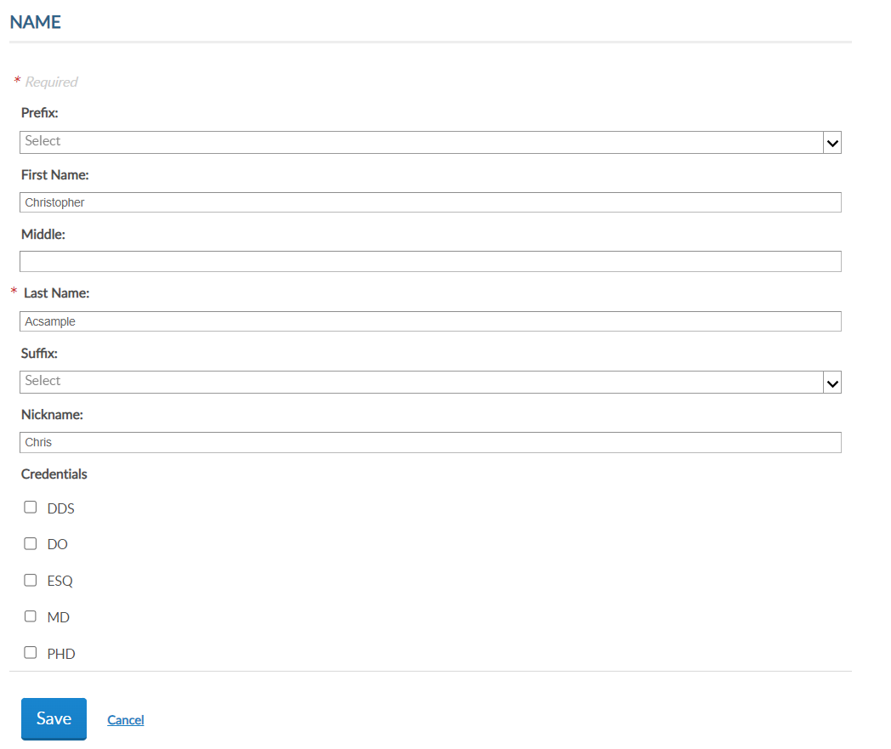
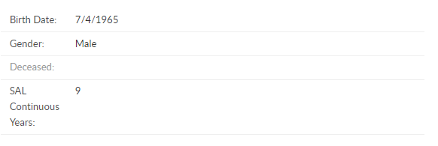
NAME & DEMOGRAPHICS
Viewing: Acsample, Christopher [Member ID: 123456789]
Viewing: Acsample, Christopher [Member ID: 123456789]
Viewing: Acsample, Christopher [Member ID: 123456789]
5
Notes:
This area has 2 sections, each with an edit button. Use the top edit button to edit name. <1> Always save when updates are made.

Slide 15
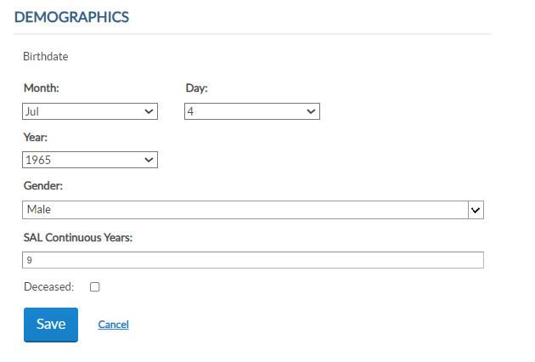
NAME & DEMOGRAPHICS
Viewing: Acsample, Christopher [Member ID: 123456789]
Viewing: Acsample, Christopher [Member ID: 123456789]
Viewing: Acsample, Christopher [Member ID: 123456789]
5
5
Notes:
To update date of birth, gender, continuous years and deceased status, click on the Edit button in the Demographics area. <1> Enter updates and Save. Please note, you cannot remove deceased status through MyLegion. If a member is flagged as deceased in error, contact your department or detachment headquarters.

Slide 16

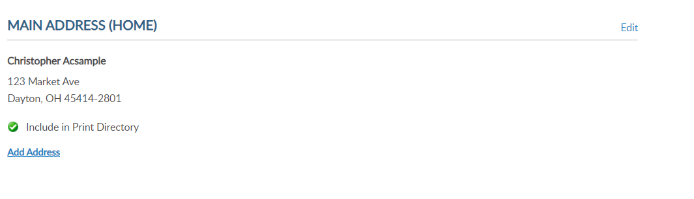
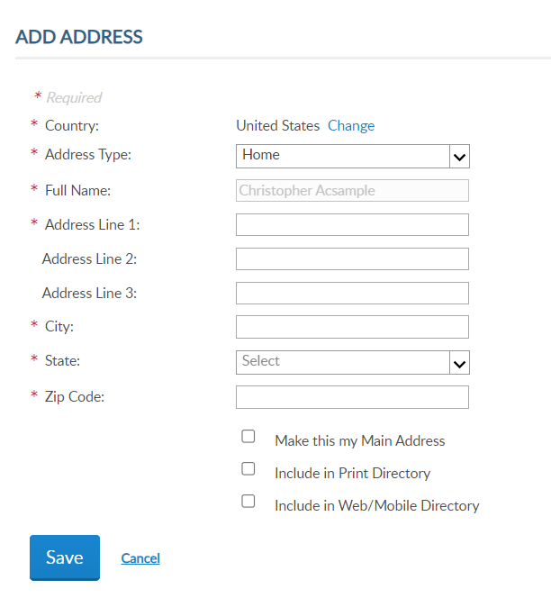
ADDRESSES
Viewing: Acsample, Christopher [Member ID: 123456789]
Notes:
Addresses allows you to update existing addresses or add an additional address to the member’s record. Members are required to have one main, or primary, address. The primary address listed on a member record determines where the address communications are sent for renewal notices, campaigns, and membership information. The main address cannot be deleted.
Some members may need an additional address on file for mailing subscriptions, or committee and officer correspondence. To add an additional address, click Add Address. <1> Selecting “Make this my main address” will make this your primary mailing address. Enter address information and save.

Slide 17
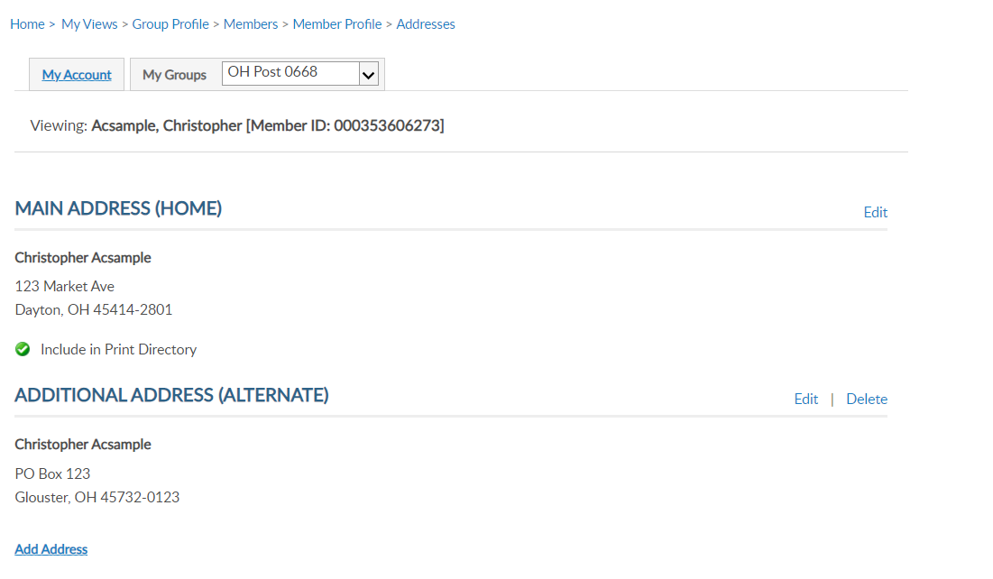
ADDRESSES
Viewing: Acsample, Christopher [Member ID: 123456789]
Notes:
The member record now has 2 addresses on file. Notice delete is now available. Delete only appears for alternate contact information.

Slide 18
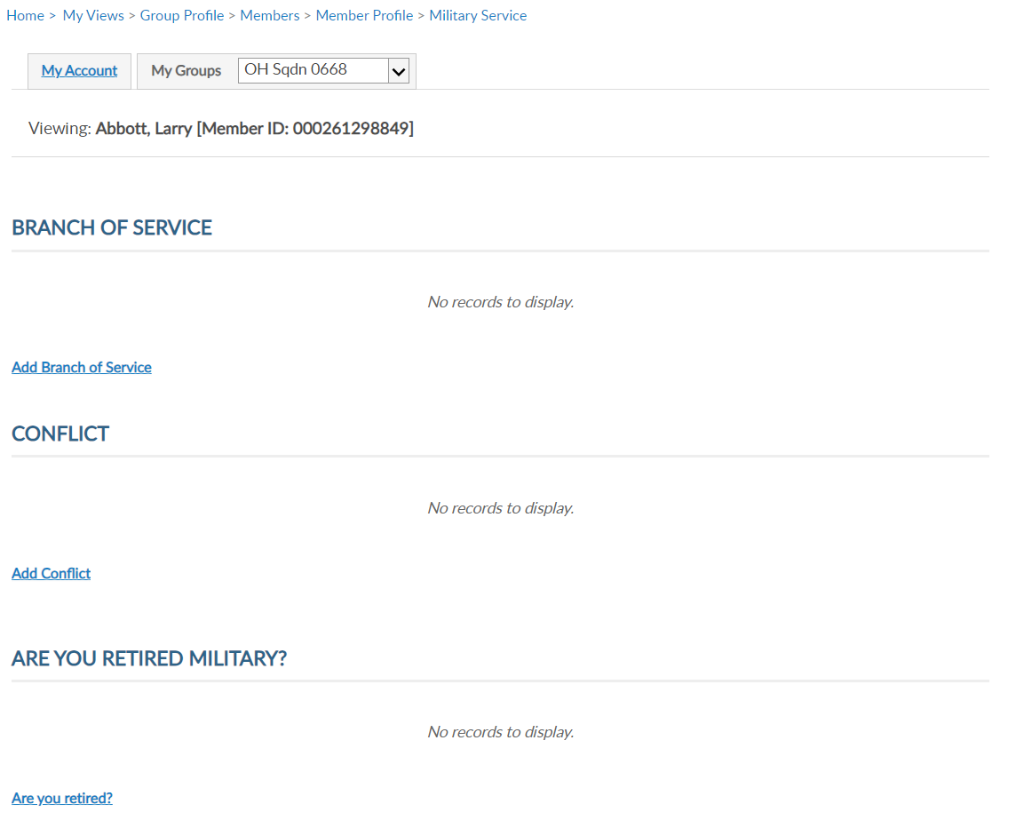
MILITARY SERVICE
Viewing: Acsample, Christopher [Member ID: 123456789]
Viewing: Acsample, Christopher [Member ID: 123456789]
Notes:
Military Service includes branch of service, conflict and retirement information. This information is not applicable for SAL Membership.

Slide 19
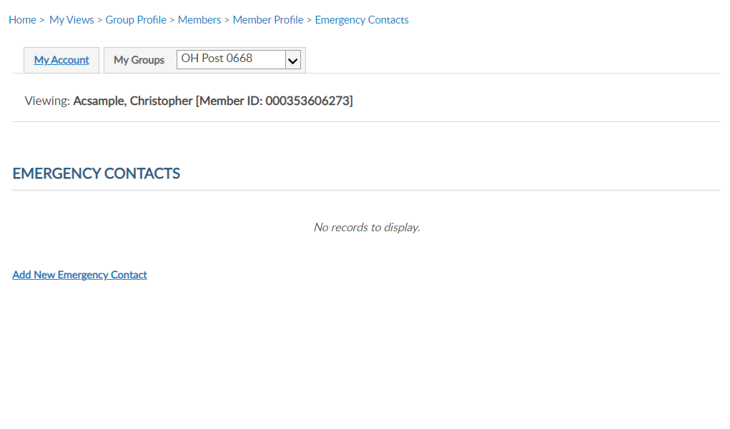
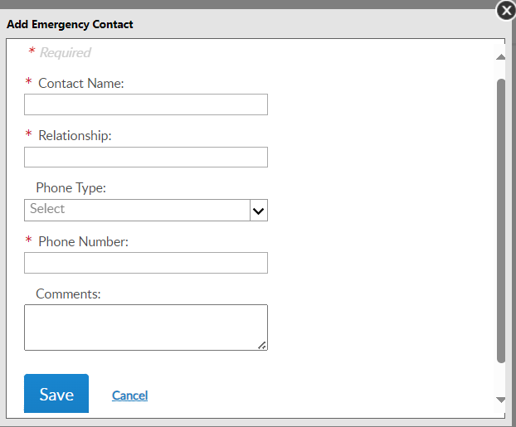
EMERGENCY CONTACTS
Viewing: Acsample, Christopher [Member ID: 123456789]
Viewing: Acsample, Christopher [Member ID: 123456789]
Notes:
Store emergency contact information in case of an emergency. <1> Enter emergency contact name, relationship, phone number, any comments and “Save”. - This information can be seen by department and national staff in case of an emergency if the member attends events and conventions or local activity of The American Legion or Sons of The American Legion.

Slide 20
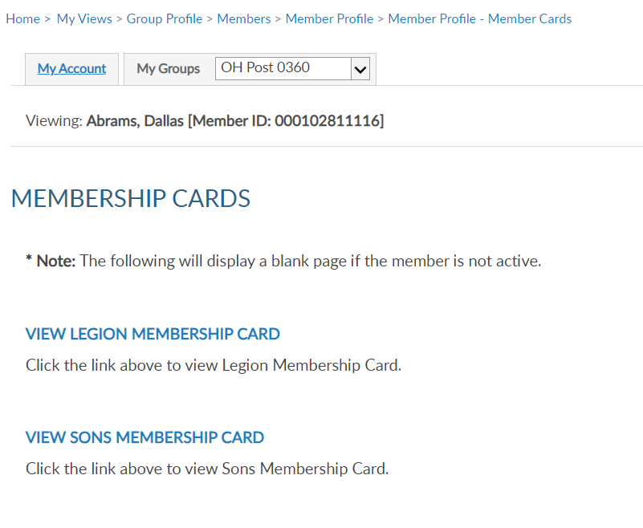
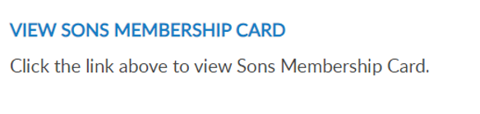
MEMBERSHIP CARDS
Viewing: Acsample, Christopher [Member ID: 123456789]
Viewing: Acsample, Christopher [Member ID: 123456789]
5
Notes:
Print a membership card for a member. Click “membership card”. <1> Members who have both Legion and Sons of the American Legion members will have 2 options. <2> Only current membership cards are available. This page will display as blank if membership is not active. Click on the link to view and print a card.

Slide 21
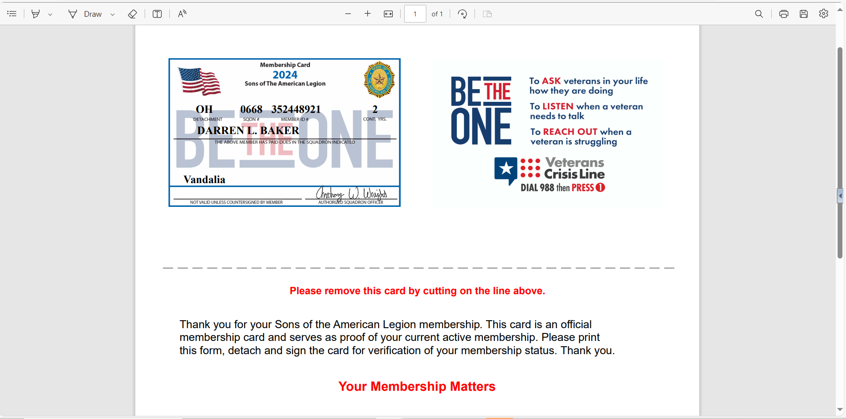
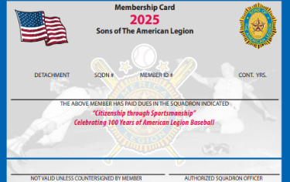
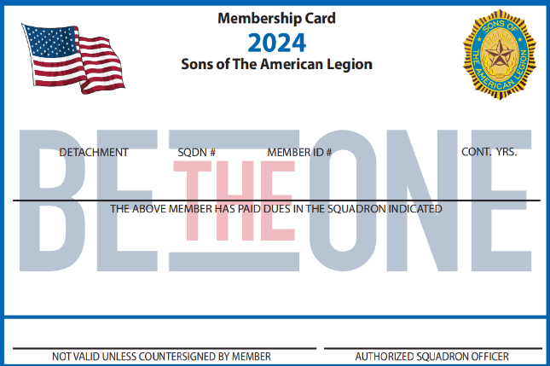
MEMBERSHIP CARDS
OH 0668 123456789 5
CHRISTOPHER ASAMPLE
Vandalia
Notes:
A pdf document will open in your browser to save or print. <1>

Slide 22
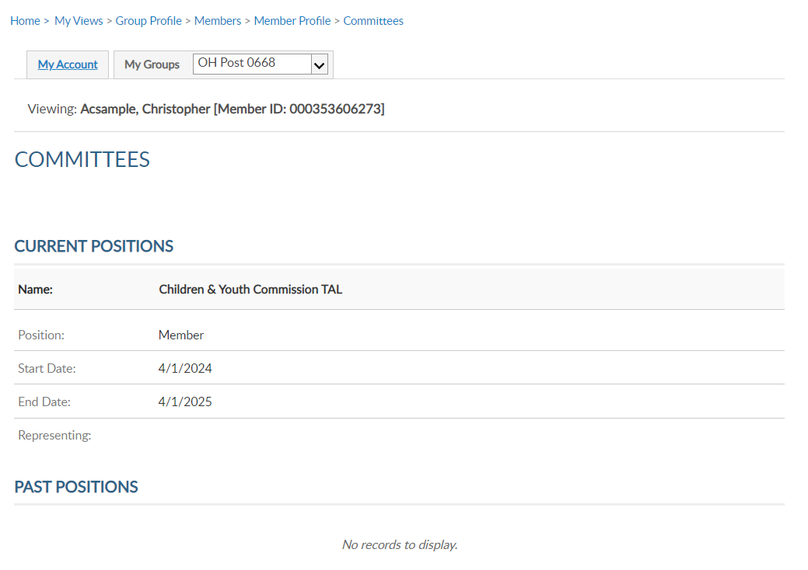
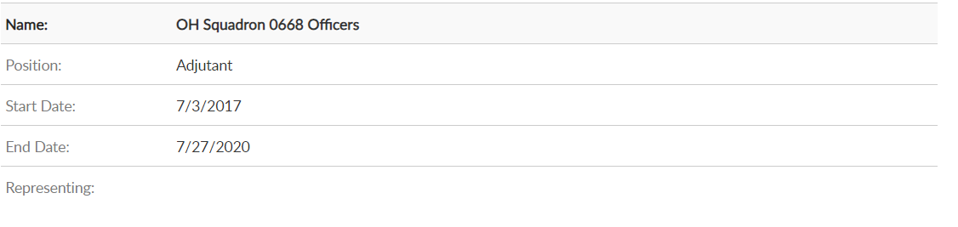
COMMITTEES
Viewing: Acsample, Christopher [Member ID: 123456789]
Viewing: Acsample, Christopher [Member ID: 123456789]
7/3/2023
Notes:
Committees lists offices held that are recorded on National’s membership system. It will display current and past positions.
This area is view only and reflects officers reported to National HQs. Officer updates are reported through your detachment using a squadron officers certification form. Incorrect committee information should be reported to your detachment.

Slide 23
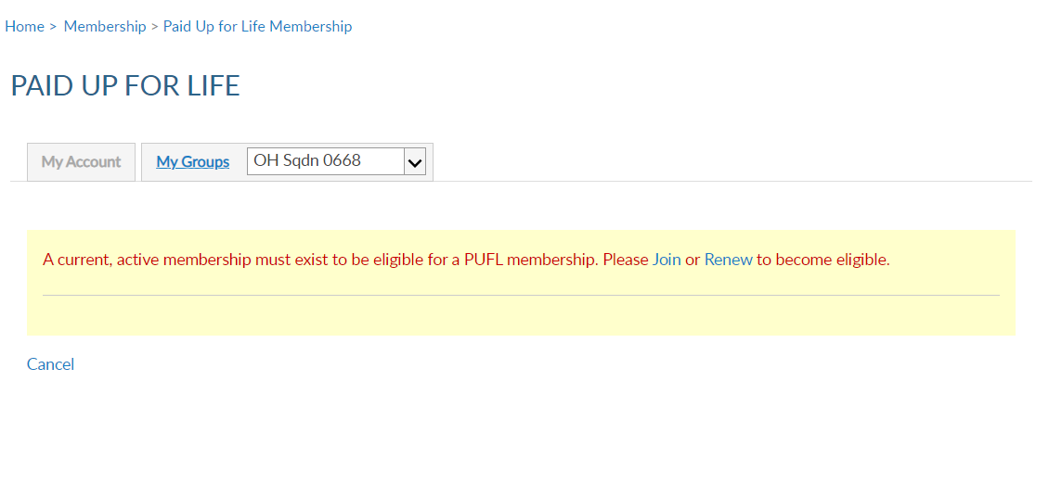
PAID UP FOR LIFE
LEGION MEMBERS ONLY
Viewing: Acsample, Christopher [Member ID: 123456789]
Notes:
Paid up for life is a National Legion program. No life membership exists for SAL members.

Slide 24
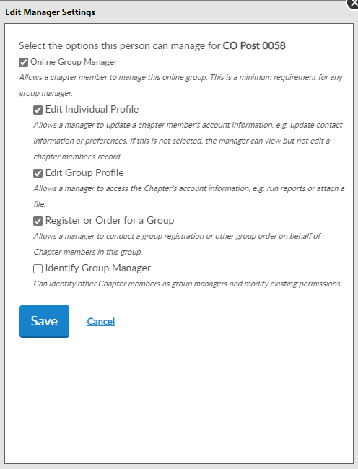
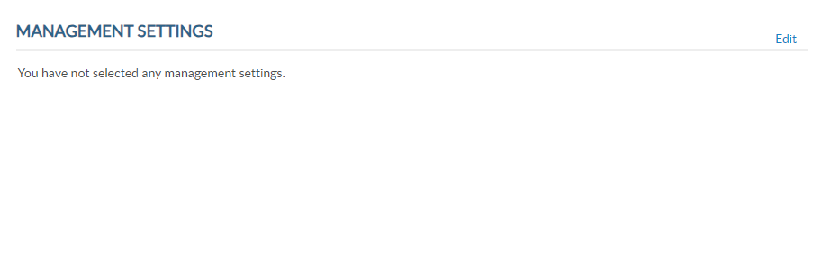
ASSIGN GROUP PERMISSIONS
Viewing: Acsample, Christopher [Member ID: 123456789]
OH Sqdn 0668
Notes:
Assign group permissions should be used with caution. This tool allows adjutants and commanders to grant access to other members.
To add, delete or edit management settings, click edit. <1>

Slide 25
ASSIGN GROUP PERMISSIONS
OH Sqdn 0668
Online Group Manager
Minimum Requirement
View and print member list.
Quick link to email address.
Notes:
To provide the same access adjutants and commanders have select:
Online Group Manager is the minimum permission requirement. It provides access to view members and a quick link to member email addresses. Selecting this option only results in view only and records cannot be updated.

Slide 26
ASSIGN GROUP PERMISSIONS
OH Sqdn 0668
Edit Individual Profile
Edit member information
Edit Group Profile
Online Membership Tools: View Members, Global Member Lookup, Group Attributes, Reports/Labels, and Officer Materials.
Notes:
Check Edit Individual Profile to grant authority to add and edit member information. <1> Edit Group Profile provides access to View Members, Global Member Search, Group Attributes. Reports, Letters, Labels and Officer Materials.

Slide 27
ASSIGN GROUP PERMISSIONS
OH Sqdn 0668
Register or Order for a Group
Allows online membership processing, Add/Modify Transmittal.
Identity Group Manager
ADJUTANTS AND COMMANDERS ONLY.
Notes:
Register or Order for a group is now the setting to allow other members to process membership online using Add/Modify transmittal. This permission allows the member to renew, transfer and add new members as well as update payment information.
<1> The last setting is only available to adjutants and commanders. This setting allows the member to provide management settings for other members.
After the desired management settings are assigned, click on the Save button.

Slide 28
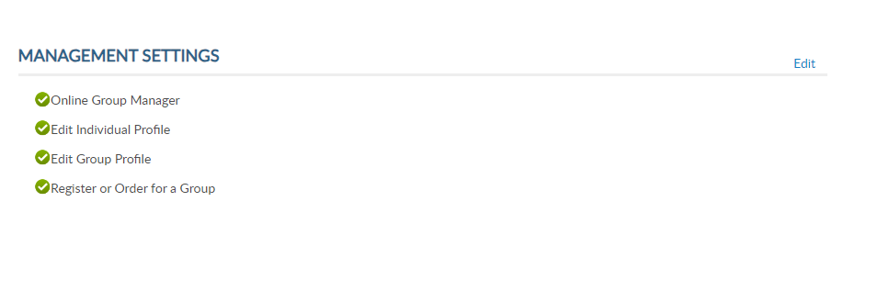
ASSIGN GROUP PERMISSIONS
Viewing: Acsample, Christopher [Member ID: 123456789]
* Monitor access using MyLegion Access report.
* Contact detachment headquarters to add end date.
Notes:
Permissions added will display. The next time the member logs into their myLegion account, they will have access group membership.
Select back to view members to search more names or select Group Profile to return to the group home page.
No end date is set when applying these permissions. Permissions can be removed by returning to Edit and unchecking the selections. It is important to keep track of anyone given permissions.
<1> You can monitor members with access to your group in MyLegion in reports. Learn more about reports in Find Help. <2> To ensure members with permissions are monitored we suggest you contact your detachment headquarters or MyLegion support team to add an end date. Adding an end date will remove permissions to allow any new officers or existing officers to review the members administrative needs and re-assign if needed.
<3> Click Back to View Members to return to the member listing.

Slide 29
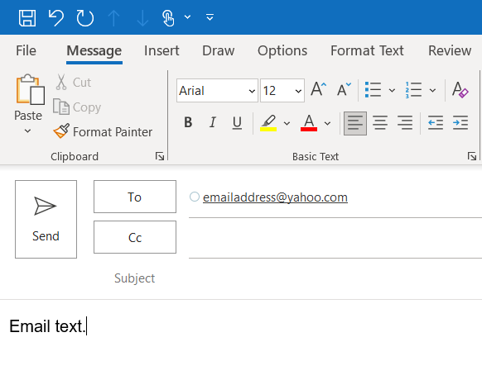

EMAIL MEMBER
222555111
Aaron, Greg
Address, City, St Zip
Email Address
Phone Number
2025
112332145
Aaron, Kevin
Address, City, St Zip
Email Address
Phone Number
2025
123456789
Asample, Christoper
Address, City, St Zip
Email Address
Phone Number
2025
122333444
Axel, Jack
Address, City, St Zip
2025
111333222
Bam, Joshua
Address, City, St Zip
2025
222555777
Black, Brian
Address, City, St Zip
Email Address
Phone Number
2025
225558441
Cook, Ralph
Address, City, St Zip
2025
Notes:
Emails can be sent from MyLegion. From the View Members listing, you can search a member, or a group of members and send an email.
To email and individual member, search them and click on the email hyperlink. <1> This opens your email browser to write and send an email. <2>
The default email browser is Microsoft Outlook. <3> If you are using another browser such as gmail or yahoo, it will be required to set your browser-based email default preference.
The number of records emailed at one time and per day is also limited per the email client. Generally, 100 per email and 500 per day. Check with the email client for limitations.

Slide 30



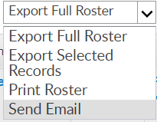
Email a Group of Members
EMAIL MEMBERS
222555111
Aaron, Greg
Address, City, St Zip
Email Address
Phone Number
2025
112332145
Aaron, Kevin
Address, City, St Zip
Email Address
Phone Number
2025
123456789
Asample, Christoper
Address, City, St Zip
Email Address
Phone Number
2025
122333444
Axel, Jack
Address, City, St Zip
2025
111333222
Bam, Joshua
Address, City, St Zip
2025
222555777
Black, Brian
Address, City, St Zip
Email Address
Phone Number
2025
225558441
Cook, Ralph
Address, City, St Zip
Notes:
Email a group of members by first selecting View All. <1> Then search and filter records as needed. Select all records by clicking the checkbox in the title row. <2> Using the Actions menu, <3> choose Send Email and click Go.

Slide 31
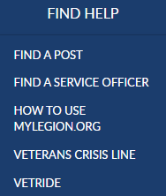
Online Help
000123456789
PrimaryEmailAddress.com
000123456789
Notes:
Online help is available from the top Menu “Find Help”.
Step by step instructions, videos and training presentations will assist with how to manage groups in MyLegion.

Slide 32
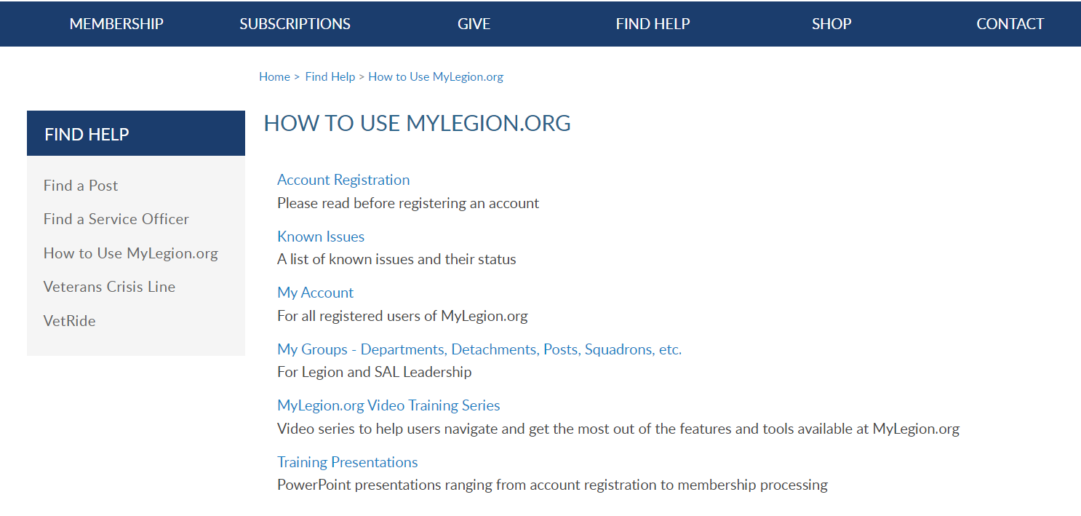
Online Help
Notes:
Step by step instructions, videos and training presentations will assist with how to manage groups in MyLegion. My Groups instructions include managing membership, online, membership processing, reports and all other administrative tasks.

Slide 33
MYLEGION SUPPORT
MyLegion@legion.org
833.253.9995
Monday – Friday
8:00am – 4:30pm
(Eastern)
The American Legion National HQs
5745 Lee Road
Indianapolis, IN 46216
Contact your MyLegion support team to assist with any questions or tools on your MyLegion account.
Notes:
Contact your myLegion support team to assist with questions and tools for MyLegion. Email mylegion@legion.org or call 833-253-9995 Monday through Friday.

